Slide 1
DE-GAN: A Conditional Generative Adversarial Network for Document Enhancement
19BCE1223- Swati Singh
19BCE1267- Aparna Katyaayni
19BCE1229-Zeel

Slide 2
ABSTRACT
Documents often exhibit various forms of degradation, which make it hard to be read and substantially deteriorate the performance of an OCR system. The system proposed is an effective end-to-end framework named Document Enhancement Generative Adversarial Networks (DE-GAN) that uses the conditional GANs (cGANs) to restore severely degraded document images. We demonstrate that, in different tasks (document clean up, binarization, deblurring and watermark removal), DE-GAN can produce an enhanced version of the degraded document with a high quality. In addition, our approach provides consistent improvements compared to state-of-the-art methods over the widely used DIBCO 2013, DIBCO 2017 and H-DIBCO 2018 datasets, proving its ability to restore a degraded document image to its ideal condition. The obtained results on a wide variety of degradation reveal the flexibility of the proposed model to be exploited in other document enhancement problems

Slide 3
INTRODUCTION
AUTOMATIC document processing consists in the transformation into a form that is comprehensible by a computer vision system or by a human.
Thanks to the development of several public databases, document processing has made a great progress in recent years.
However, this processing is not always effective when documents are degraded. Lot of damages could be done to a document paper. For example: Wrinkles, dust, coffee or food stains, faded sun spots and lot of real-life scenarios.

Slide 4
Degradation could be presented also in the scanned documents because of the bad conditions of digitization like using the smart-phones cameras (shadow, blur, variation of light conditions, distortion, etc.). Moreover, some documents could contain watermarks, stamps or annotations.
The recovery is even harder when certain types of these later take the text place for instance in cases where the stains color is the same or darker than the document font color .
Hence, by using C-GAN approach we will try to recover a clean version of the degraded document.

Slide 5
Cgan- Proposed Method
It consists of two parts:
Generator
Discriminator

Slide 6
Generator
Given a label and random array as input, this network generates data with the same structure as the training data observations corresponding to the same label
Discriminator
Discriminator — Given batches of labeled data containing observations from both the training data and generated data from the generator, this network attempts to classify the observations as "real" or "generated".

Slide 7
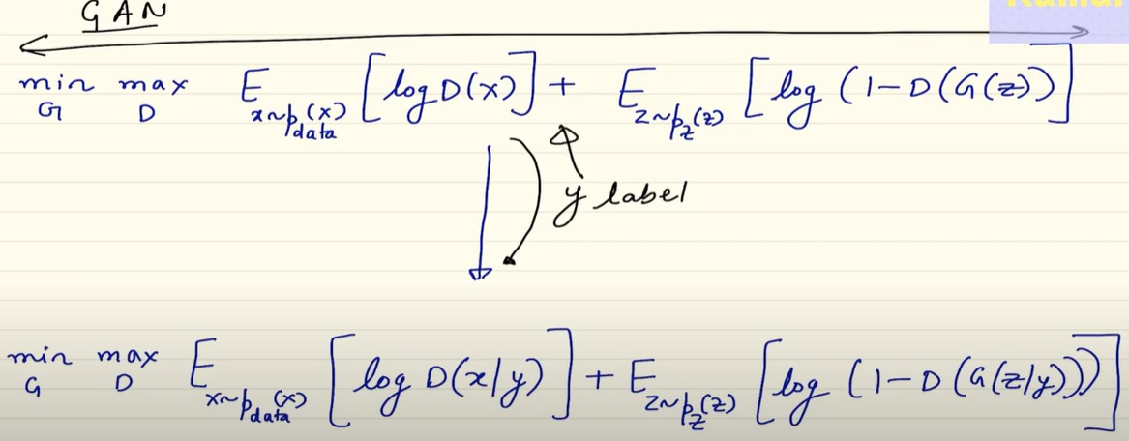

Slide 8
Areas of work DOCUMENT CLEAN-UP And Binarization
The goal is to produce a binary but clean document.
The idea is to classify the pixels of the document as one of two categories: degradation or text.
By assigning zeros to the text pixels and ones for the degradation will generate a binary clean image.
The objective is to clean the degraded document images and preserve them in their basic grey or colored level.

Slide 9
Watermark removal
Watermark removal is also related to classical document binarization or image matting.
A statistical method is used to detect the watermark region.
So, object detection algorithms are used to detect the watermark region in natural images and then pass it to other model to remove the watermark.

Slide 10
Image Enhancement
Image enhancement includes various image cleaning tasks that are usually a
pre-processing task for other major tasks like object detection, feature extraction, autonomous driving applications etc. Various image enhancement tasks include: Dehazing, Deblurring, Deraining….
Deblurring as a task (Traditional Approaches)
Blurry images are caused due to motion of the camera lense, rotational components, or slight movement on the part of the target itself.
The blur is modelled by the following equation:
IB = k(M) * IS + N
IB is the blurry image IS is the sharp image
k(M) is the unknown blur chanel
* the convolution operation

Slide 11
GAN based Deep Learning
Generative Adversarial networks
Main concept is very clear. Generator tries to fool the discriminator.
In general training is tough
Two networks need to converge simultaneously
One has to be kept frozen while other trains.
Used mainly for image to image mapping problems where general methods fail.
DeblurGAN
DeblurGAN is an end-to-end learned method for deblurring based on conditional GAN and content loss. It achieves state of the art performance both in structural similarity and visual appearance.
The original paper is implemented in PyTorch and uses VGG-19 feature maps for perceptual loss, while our implementation uses Keras with Tensorflow backend, along with VGG-16 for perceptual loss.

Slide 12
Dataset
The dataset we chose was the Go_Pro-Large Dataset. It consists of 2103 train images and 1111 test images as a default train test split.
Preprocessing
Each image was preprocessed using python scripts into a numpy file in a “.NPY” format. This reduced the dataset from 8.9GB to 1.3GB. Moreover while looping during training, the images in NPY format are loaded faster and thus the training process is faster. This was learnt and used by past experience of team members while training networks.
So, after preprocessing, all our files were present as 256x256x3 numpy arrays arranged suitably in files and folders to facilitate an appropriate train-test divide.

Slide 13
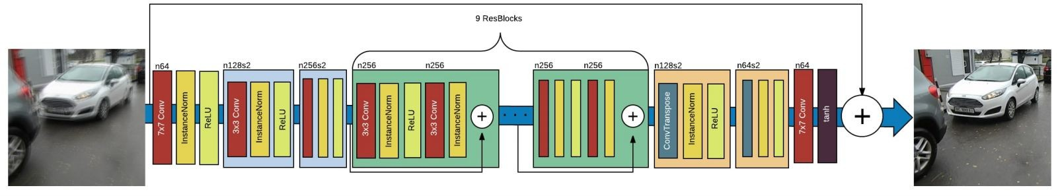
Referred implementation
We focussed our entire attention on the network architecture and training (which is the task given to us). The figure below shows the pictorial representation of the generator network from the original DeblurGAN paper.
Link to Google Colab Implementation

Slide 14
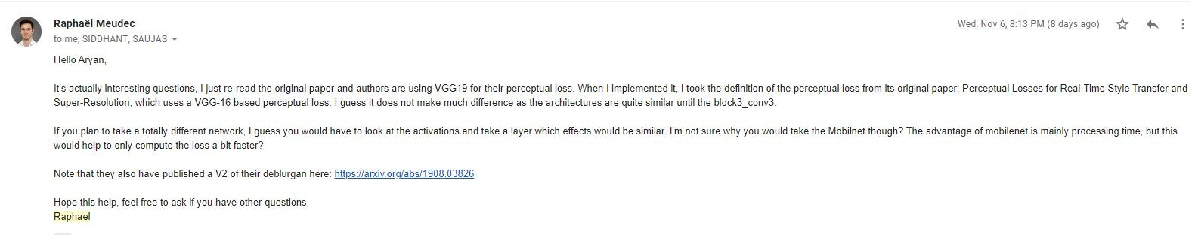
Training parameters and choices along the way..
We trained for 200 epochs (original implementation was 300 epochs)
Perceptual loss is implemented using VGG16 one by one instead of MobileNetv2 as communicated with TA and also with Russian data scientist Raphael Meudec who is the owner of the official DeblurGAN keras implementation repository on github.

Slide 15
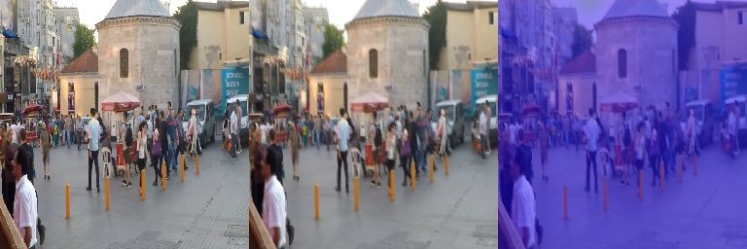
Nevertheless, we tried with MobileNetv2 as well !
Results with MobileNetv2 have a clear bluish tinge, and deblurring was also not visible, which means that layers analogous to block3-conv3 of VGG-16 are not easily identifiable in MobileNetv2 because of a completely different architecture.

Slide 16
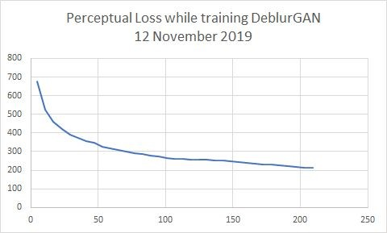
Visualising training and model convergence, with VGG-16
We trained for 200 epochs (original implementation was 300 epochs)
We stopped after 200 because of time constraints and more importantly because of early stopping to prevent overfitting. The number of images is only 2000. The dataset, although large, is not very diverse.
38%|███▊ | 38/100 [2:14:42<3:38:10,
211.14s/it]
-0.49999999979138376 228.23302
63%|██████▎ | 63/100 [3:43:01<2:10:16,
211.25s/it]
-0.49999999623000624 215.76013
100%|██████████| 100/100 [5:53:41<00:00, 211.88s/it]
-0.5 205.53262

Slide 17
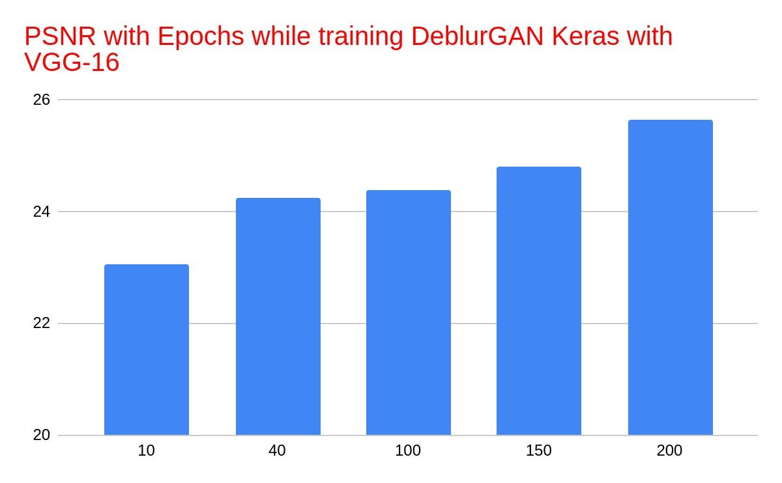
Live Epoch-wise PSNR reduction.
The PSNR is seen to be steadily increasing while training. So we knew our model was converging well.

Slide 18
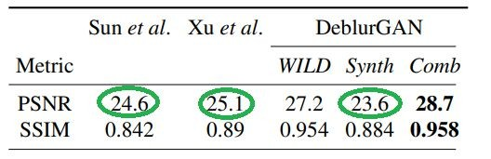
Final Quantitative Analysis
Model | PSNR | SSIM
DeblurGAN Original Paper | 28.7 | 0.9580
Our Implementation | 25.4 | 0.8208
Our preliminary implementation trained for only 200 epochs is able to beat 3 out of 5 relevant state of the art in Deblurring, that are equal to or below the stated implementation of DeblurGAN

Slide 19

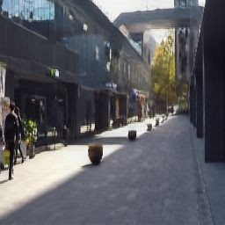
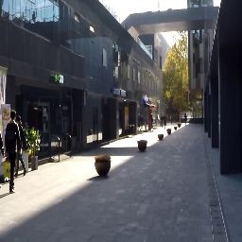
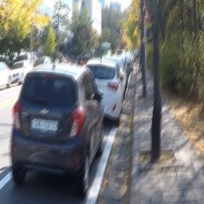
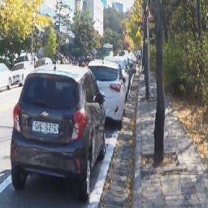
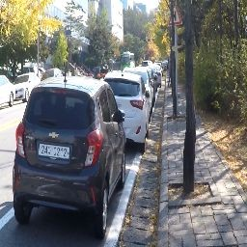
Qualitative Analysis
No contextual loss
No additional haze/blur introduced
Visual appeal
No contrast present
No image enhancement required
Blurry
Predicted
Target

Slide 20
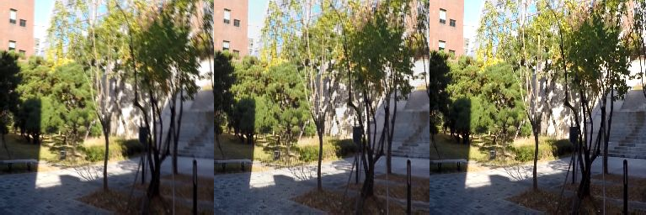
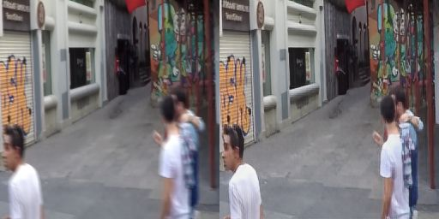
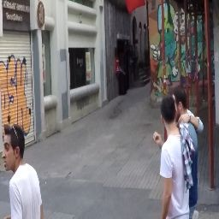
Qualitative Analysis
No contextual loss
No additional haze/blur introduced
Visual appeal
No contrast present
No image enhancement required
Blurry
Predicted
Target

Slide 21
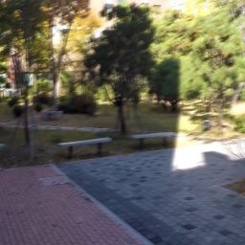
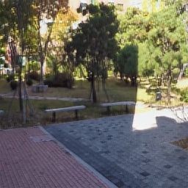

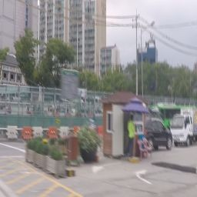
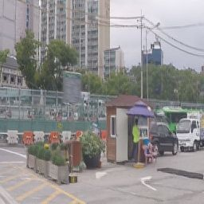

Qualitative Analysis
No contextual loss
No additional haze/blur introduced
Visual appeal
No contrast present
No image enhancement required
Blurry
Predicted
Target

Slide 22
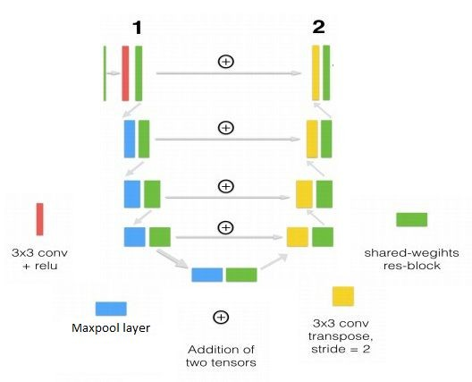
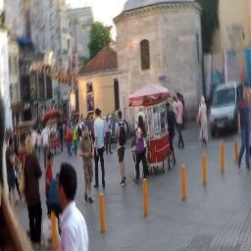


CNN based extension…
We designed a shallow CNN just to test and learn more about why GANs were chosen for this problem statement?
Our CNN was based on UNET like structure with 3 encoder and 3 decoder blocks and three skip connections.
RESULTS PSNR:
Ranges between 22.707
and 27.277512 !!!
And the image is still blurry !!

Slide 23
Timeline and Work Summary
15 Day Timeline based on correspondence with Saksham Consul (TA)
Day1: Preprocessing (NPY file generation and cropping)
Day 2 and 3: GAN coding
Day 4: MobileNetv2 exploration for perceptual loss
Day 5: Communication with data scientist (Raphael Meudec), peers and TA mentor
Day 6, 7 and 8: GAN coding and training
Day 9 and 10: Training on Co-lab, IPC servers and local machines
Day 11 and 12: Testing for PSNR and SSIM
Day 13 and 14: Extension of work for CNN based Deblurring
Day 15: Presentation work

Slide 24
Results and Conclusions !
We successfully implemented perceptual loss and how it is better than PSNR for our problem.
We successfully understand how GANs are trained by freezing weights of discriminator while training the generator. And how 2 lossed are combined while compiling the model.
We got a PSNR of 25.4 and SSIM of 0.8208
Our model successfully deblurs the images without loss of context and contrast
Our model successfully converged (Both Generator and Discriminator together !!)
We extended the project and compared our results to a shallow CNN, showing why GANs are prefered over CNN in such tasks.

